Slide 1
MCSW Legislative Briefing
May 23, 2024

Slide 2
Welcome & Opening Remarks
Public Hearing Findings
MCSW Legislative Priority Updates
Questions
Closing
Today’s Agenda

Slide 3
Today’s
Speakers
Mary-dith Tuitt
MCSW Vice Chair & Chair of Legislative Committee
Guimel DeCarvalho
MCSW Vice Chair of
Legislative Committee
Shaitia Spruell
MCSW Executive Director
MCSW Program & Planning
Vice Chair Jean Fox
Divya Chaturvedi
MCSW Finance Committee Vice Chair
Sunny Daily
CCISW
Commissioner & Doula
Laura Cabrera
Berkshire County Commissioner
Brianna Sullivan
Essex County Commissioner

Slide 4
The mission of the Commission is to advance women toward full equality in all areas of life and to promote rights and opportunities for all women and girls.
The Commission exists to provide a permanent, effective voice for women across Massachusetts.
Notes:
The Massachusetts Commission on the Status of Women was legislatively created in May 1998 and became operational in early 1999. The legislation was inspired by the United Nations’ Fourth World Conference on Women, which was held September 1995 in Beijing, China. The result of this conference, The Beijing Platform for Action, in addition to many other things, directed state governments to "form and adequately fund Women’s Commissions in all states and territories where they do not already exist."
Massachusetts’ delegates to the Beijing Conference, including then Massachusetts First Lady Susan Roosevelt Weld, returned determined that Massachusetts would have its own Women’s Commission. Their passion and commitment led to the creation of a coalition of dedicated women that met regularly over the course of several years to bring this dream to fruition.

Slide 5
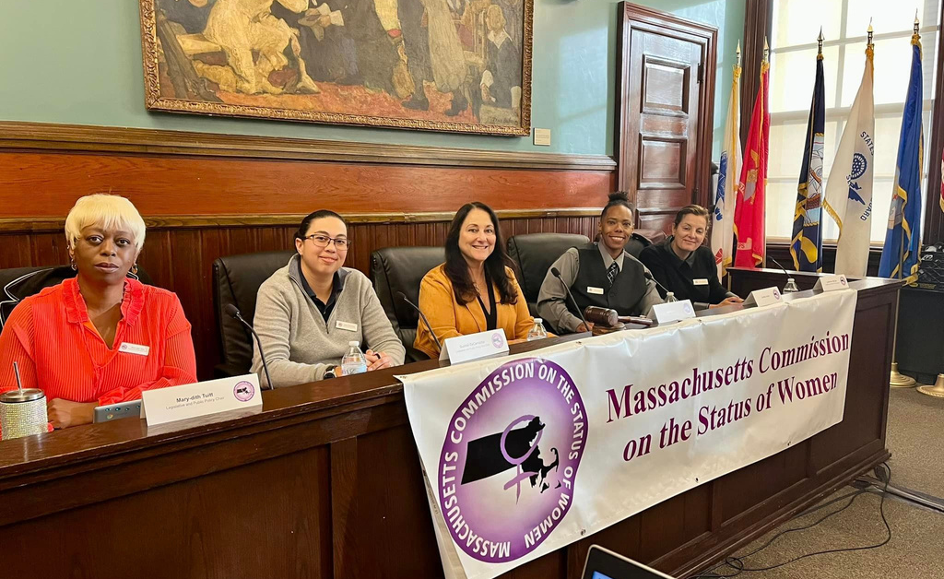
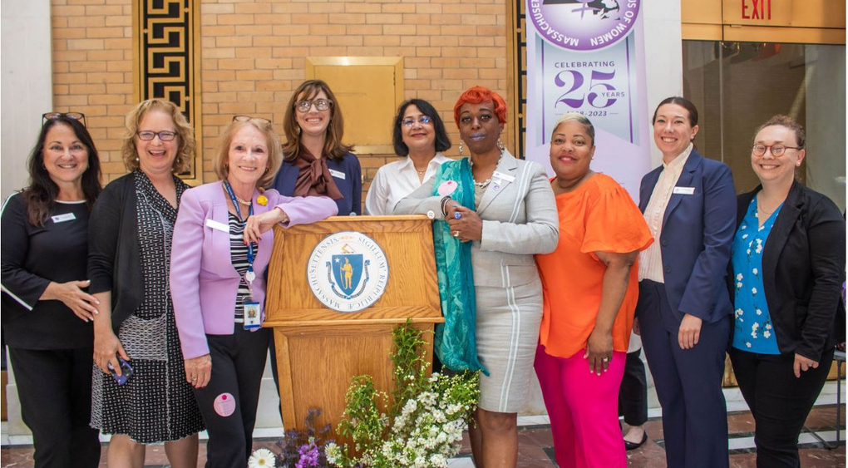
Who We Are
Notes:
Ultimately, with the help of many, particularly state legislators, they were able to fashion a unique and model Commission – with appointing authority shared by the Executive and Legislative branches. When the Commission was created, it was funded by a line item in the state budget.
The current MCSW was preceded by Governor’s Commissions on the Status of Women, which sunset with each governor’s administration.

Slide 6
The MCSW is empowered to:
Study, review and report on the status of women in the Commonwealth
Advise executive and legislative bodies on the effect of proposed legislation on women
Inform leaders of business, education, health care, state and local governments, and the communications media of issues pertaining to women
Identify and recommend qualified women for positions at all levels of government
Promote and facilitate collaboration among local women’s commissions and among women’s organizations in the state

Slide 7
Findings from Public Hearings

Slide 8
Dartmouth Public Hearing
Key Issues Discussed
Housing insecurity
Early education
Menstrual product accessibility
Diversity on public boards
Access to Healthcare/Birthing justice/Doula services
Economic stability
Gender-based discrimination/violence
Measures to promote the well-being
Empowerment of all residents in the region
Legislative Recommendations Heard
Initiatives promoting economic security and housing stability
An Act Providing Affordable and Accessible High-Quality Early Education and Care to Promote Child Development and Well-being and Support the Economy in the Commonwealth (S.2707/H.489)
An Act to increase access to disposable menstrual products (S.2491/H.534)
An Act to Promote Diversity on Public boards and Commissions (H.3095/S.2029)
An Act relative to birthing justice in the Commonwealth (S.2734)

Slide 9
Virtual Housing Public Hearing
Key Issues Discussed
Rent Control/Rent Stabilization
Eviction Protections
Affordable Housing
Access to disability benefits
Domestic Violence
Houseless population
Support for rural communities, women veterans and elders
Legislative Recommendations Heard
The Affordable Homes Act Bonding, Capital Expenditures & State Assets(H.4138)
An Act Enabling Local Options for Tenant Protections (H.1304)
An Act Promoting Housing Opportunity and Mobility Through Eviction Sealing (HOMES) (H.1690)
An Act Promoting Access to Counsel and Housing Stability in Massachusetts (H.4360/S.864)
An Act to Establish an Office of Fair Housing and a Fair Housing Trust Fund (H.1377/S.866)
An Act Creating the Massachusetts Healthy Homes Program (H.1307/S.881)
An Act Relative to the Massachusetts Rental Voucher Program (H.1351/S.888)

Slide 10
Gardner Public Hearing
Key Issues Discussed
Predatory Lending against Women
Healthy Youth Act
Nursing/Birthing Justice
Housing Discrimination
Legislative Recommendations Heard
An Act Relative to Healthy Youth - Healthy Youth Act (S.2694/H.544)
An Act to Establish a Resolution Trust Fund for Receipt of Reasonable Mortgage Payments (H.3953)
An Act Relative to Birthing Justice in the Commonwealth (S.2734)
An Act Establishing Medicare for All in Massachusetts (H.1239/S.744)
An Act relative to non-disclosure agreements relating to a claim of discrimination, non-payment of wages or benefits, retaliation, harassment or violation of public policy in employment (H.1870)

Slide 11
Legislative Priority Highlights

Slide 12
An Act Relative to Language Access and Inclusion H.3084/S.1990
Bill Overview
This bill seeks to require state agencies to provide timely, culturally competent oral language services to all limited English proficiency individuals who seek to access services, programs, or activities relative to language access and inclusion.
Status
Bill reported favorably by House and Senate
Sent to Senate & House Ways & Means 10/30/2023

Slide 13
An Act Relative to Medicaid coverage for doula services H.1240/S.782
Bill Overview
The proposed bill will ensure that doula services are covered by Medicare and MassHealth. It will create a registry of doulas in order to regulate reimbursements and standardize competencies. The bill will also create a commission made up of doulas and members of communities with worse maternal health outcomes including members of the LGBTQ+ community, those dependent on MassHealth, and those who have experienced maternal or sexual trauma.
Status
Bill reported favorably by the committee and referred to Senate Ways & Means 4/8/2024

Slide 14
An Act supporting parents running for public office (PRO) H.669/S.422
Bill Overview
This bill would specify that expenses for childcare during campaigning would not be considered “personal use” expenses allowing campaign funds to be used, defined as both casual and professional services and any cost directly related to childcare that occurs due to campaigning.
Status
House Accompanied S145 9/28/2023
Senate Concurred 4/11/2024

Slide 15
An Act to increase access to disposable menstrual products (I AM) H.534/S.2491
Bill Overview
The I AM Bill, championed by lead sponsors Senator Jehlen, Representative Livingstone and Representative Barber, would ensure access to free menstrual products to all menstruating individuals in public schools, homeless shelters and incarcerated facilities. The bill also contains language to ensure the products are truly accessible without stigmatizing the individual seeking them.
Status
House-Concurred 3/4/2024
Senate-Bill reported favorably by the committee and referred to Senate Ways & Means 9/28/2023

Slide 16
Legislative Advocacy
Additional information on our
2023-2024 legislative priorities
can be found at masscsw.org.

Slide 17
Questions?
Add your questions to the chat!

Slide 18
Take our
Event Survey!
We value your feedback.
https://bit.ly/mcswlegbrief

Slide 19
MASSACHUSETTS COMMISSION ON THE STATUS OF WOMEN
1 Ashburton Place, Suite 16220,
Boston, MA 02108
THANKS FOR JOINING!
MCSW@mass.gov
Visit us at masscsw.org for more information or follow us on Facebook, Twitter, Instagram, or LinkedIn: @masscsw.

